Slide 1
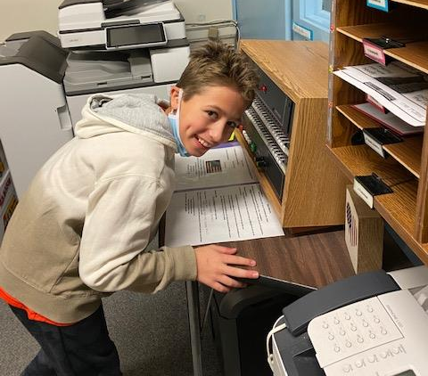
Merrymount Parent Newsletter
“If everyone is moving forward together then success takes care of itself” - Henry Ford
January 9, 2022
Thank you to Mrs. Ehrlich, Mrs. Perkins, and so many staff members who helped out this past week. Thank you to the parents and families for your communication and patience as new guidelines and changes were made for COVID-19 precautions.
Please note the email from the fifth grade team reminding students of our expectations with their chromebooks. Fourth and third graders will be receiving their chromebooks as well in the next few weeks. We will reach out to individual grade levels when that occurs.
Helpful reminders for COVID-19:
If you have any questions please make sure you email our school nurse Mollie Ehrlich and copy Ms. Mitchell onto the emails as well.
If you have a family member who is immune compromised, please reach out to us to let us know that you are at greater risk and would like to be informed of classroom contacts.
We have both adult and child size masks at school. If your child does not have a suitable mask they can always get a mask at the door, or from their teacher. Each classroom has their own supply of masks from the nurse’s office.
If you wish to sign your child up for Pooled Testing and Test and Stay, please see the below page from Mrs. Ehrlich, or visit the QPS main page for the link to consent to testing for your child.
If your child is out due to a positive case or being a close contact, your child is eligible to live stream into their classroom.
Our Grade 5 Reach Virtual Showcase for families is scheduled for 1/19 at 5pm and will be recorded (due to a scheduling conflict the 1pm showcase was cancelled).
Mrs. Ciardi will be meeting with the fourth grade REACH students once a month on Wednesdays. Room 26 will be used on these days.
Due to the forecast on Tuesday and Wednesday morning, we will have a “Drop and Go” from 7:45-8:00 a.m. to avoid having students wait outside. Bus students will be brought into the gym. All other students will then be dropped off and let in the building, we will hold attendance and tardies until 8:00 a.m. on those two mornings. We will have staff ready to walk kindergarten students into the building. You can “Drop and Go” in front of the parking lot past the crosswalk.
Thank you to Marek “Mak Attack” Konish for a fantastic job with the December announcements. Ryan Clougher will start 2022 as our new announcer!

Slide 2
Nurse - Mrs. Ehrlich
If you have any question whether your child should or shouldn’t be in school, please contact me prior to sending them in. This includes positive cases, family members or close contacts.
Positive Covid-19 students: Anyone who tests positive for COVID-19 must isolate for 5 days regardless of vaccination status or symptoms. If you have no symptoms or your symptoms are resolving after 5 days, you may return to work/school but should continue to wear a mask for 5 additional days. If you still have a fever on day 5, you must continue to isolate until you are fever-free for 24 hours (and without taking fever-reducing medications).
Vaccinated close contacts (in or out of school): Vaccinated close contacts to positive COVID-19 cases should monitor themselves and family members for symptoms but may continue to attend work/school as long as they remain symptom-free.*Fully vaccinated is defined as two-weeks following the completion of the Pfizer or Moderna series or two-weeks following the single dose of J&J vaccine.
Unvaccinated out of school close contacts: to positive COVID-19 cases must quarantine for 5 days and may return to work/school on day six (6) if they remain symptom-free.
Pool testing: Anyone who tests positive for Covid-19 must remain out of pool testing for 90 days. Please make sure you let me know if your student had a recent positive test (especially if it was a home test). To sign up for pool testing or test and stay (if eligible), please use the following link: https://www.cic-health.com/consent/ma?district=null
Mollie Ehrlich MSN,RN
School Nurse
mollieehrlich@quincypublicschools.com

Slide 3
EL - MS. CORCORAN
ACCESS for ELLs 2.0 testing is coming up!
I’ve captured images of what the actual online test will look like as Grades 1-5 will be on chromebooks. These images are from the practice test, but the format is the same; the content and questions on the actual test will assess the language associated with Language Arts, Mathematics, Science, and Social Studies across the four language domains. ACCESS resembles the MAP assessment given in Grades 2-5 as it is adaptive. The Kindergarten ACCESS for ELLs is paper-based and individually administered and uses stories and activities which helps to keep our young English Learners engaged! This test helps in identifying what language skills your child has and allows us to differentiate instruction to meet them on their proficiency level. This is also a great tool to track your child’s progress in learning academic English!

Slide 4
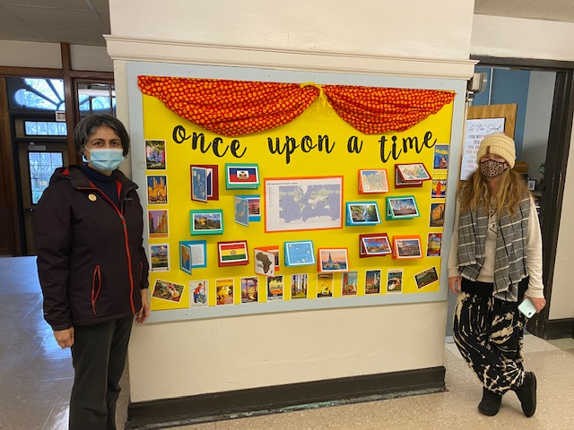
SCHOOL COUNCIL & DEI
Merrymount School Council!
We hope you can join us at our next virtual Merrymount School Council meeting on January 11, 2022 at 7pm.
Google Meet link:
meet.google.com/xda-bnhd-ade
Please email your questions and suggestions to merrymount.schoolcouncil@gmail.com
Thank you to the work of our School Council!
We have a gorgeous bulletin board: Once Upon a Time
Designed and created by: Mrs. Amy Bacchieri and Ms. Shiv Singh
All of our daily Community slides were created by Mr. Jonathan Hawes
Thank you to all of you for your dedication to Merrymount!!!

Slide 5
SCHOOL COUNCIL & DEI

Slide 6
PBIS Ticket Winners
Kindergarten | DiRocco | Bennett Wiwitted
 | Hutchinson | Huck Sweet
 | Richardson | Bridgette Byrne
Grade 1 | Coleran | Jana Alamoudi
 | Joyce | Eyad Sabek
 | Kirby | Ava Ford
Grade 2 | Bither | Patrick Murphy
 | Eckhardt | Hayden Shaw
 | Whalen | Olivia Selchan
Grade 3 | Brown | Melissa Lavey
 | Jones | Ngoc Lai
 | Lovett | James Connolly
 | Zielinski | Chloe Nguyen
Grade 4 | Baldwin | Parnika Kashikar
 | Hurley | Kai Chamberland
 | Lanham | Messiah Johnson Stevenson
Grade 5 | Campbell | Sofia Nguyen
 | Mulcahy | Nhu Lai
 | Rogan | Benjamin Long

Slide 7
Merrymount Winter Extended Day Programs The deadline to sign up for programs was 1/5/22. Please email Mr. Rogan with any questions- johnrogan@quincypublicschools.com
Program | Grade Level | Day and Time
Crazy 8s Math with Mrs. Coleran Students will engage in hands-on activities that reinforce math skills. | 1 | Monday 2:00-3:00
Creative Kids with Mrs. Joyce Let's get creative! Students will explore ways to express themselves through art. Join me for some arts and crafts, coloring activities, and origami. | 1 | Tuesday 2:00-3:00
Origami with Ms. Mitchell Students will work together to enhance their spatial skills, direction following, and hand-eye coordination as they practice the art of origami. | 2 | Monday 2:00-3:00
STEAM with Ms. Guarente Students will participate in hands on STEAM activities. Students will be able to explore the topics of science, technology, engineering, art and math. Together, we will learn to think critically, work together and be problem solvers! | 3 | Monday 2:00-3:00
STEAM with Ms. O’Leary Students will participate in hands on STEAM activities. Students will be able to explore the topics of science, technology, engineering, art and math. Together, we will learn to think critically, work together and be problem solvers! | 4 | Monday 2:00-3:00

